Slide 1
CUDA Project
Download and CUDA code, run the code and submit a report including presentation.
By Quswar (CS2003) & Sherjeel (CS1913)

Slide 2
Source Code
Sourced from Raghav Pandya’s GitHub Repo:
https://github.com/rpandya1990/Parallel-N-Body-Problem
An edited fork available at:
https://github.com/quswarabid/raghavpandya

Slide 3
Project Overview
N-body simulation
Based on Barnes-Hut Algorithm
Simulates for 10,000 rounds
Simulates for 4, 120, 240, 480, 600, and 960 bodies
Results of these are provided in following slides
Compiled & Run on GIKI’s HPC
Results may vary on different computers

Slide 4
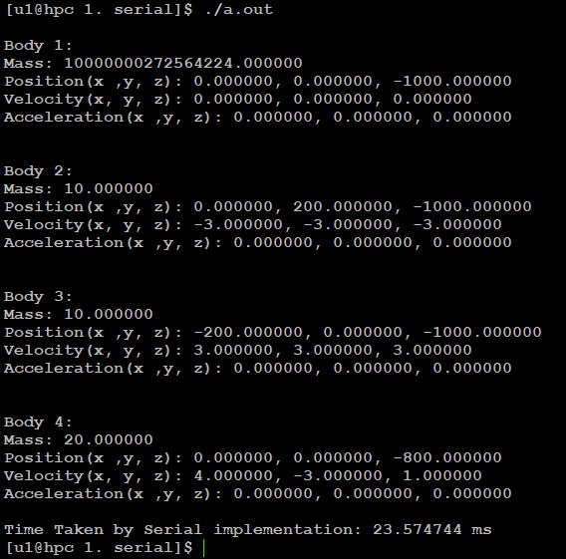
Serial simulation for 4 bodies

Slide 5
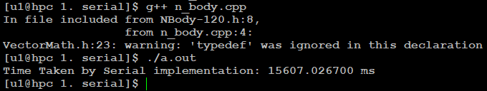
Serial simulation for 120 bodies

Slide 6
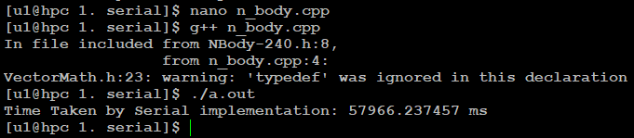
Serial simulation for 240 bodies

Slide 7
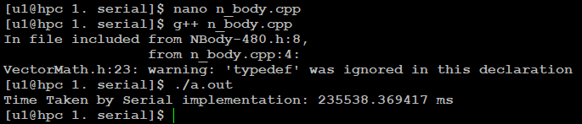
Serial Simulation for 480 bodies

Slide 8
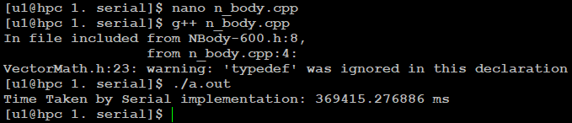
Serial simulation for 600 bodies

Slide 9

Serial simulation for 960 bodies

Slide 10
Time taken by Serial Simulation
Number of bodies | Time to simulate for 10,000 rounds (in ms)
4 | 23.574744
120 | 15,607.0267
240 | 57,966.237457
480 | 235,538.369417
600 | 369,415.276886
960 | 941,173.343297

Slide 11
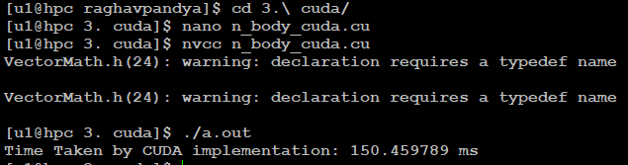
Parallel simulation for 4 bodies

Slide 12
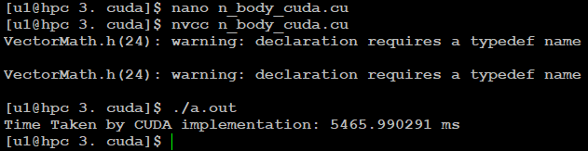
Parallel simulation for 120 bodies

Slide 13
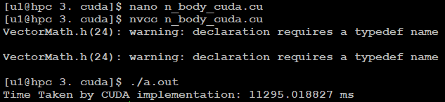
Parallel simulation for 240 bodies

Slide 14
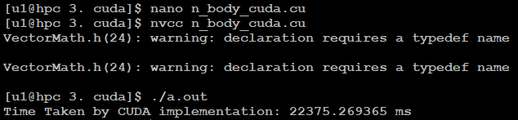
Parallel simulation for 480 bodies

Slide 15
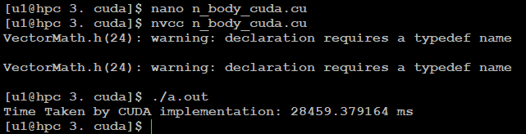
Parallel simulation for 600 bodies

Slide 16
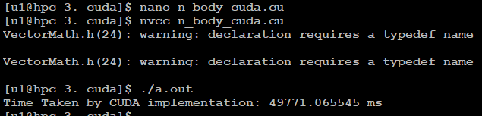
Parallel simulation for 960 bodies

Slide 17
Time taken by Parallel Simulation
Number of bodies | Time to simulate for 10,000 rounds (in ms)
4 | 150.459789
120 | 5,465.990291
240 | 11,295.018827
480 | 22,375.269365
600 | 28,459.379164
960 | 49,771.065545

Slide 18
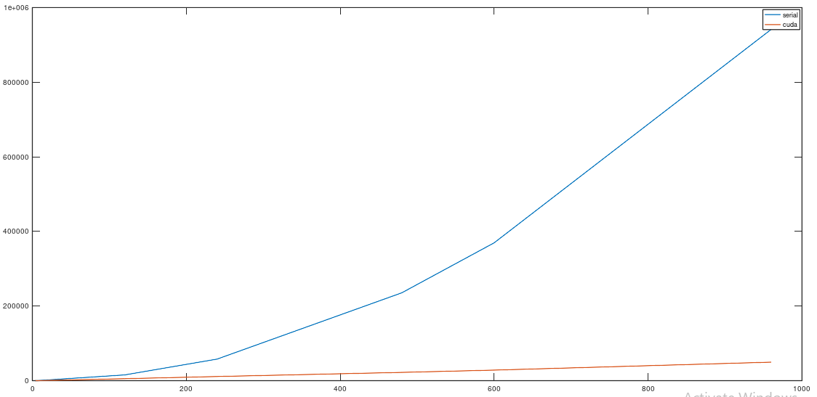
Comparison chart of performance time against number of bodies

